Slide 1
Amrita School of Artificial Intelligence, Faridabad
Amrita Vishwa Vidyapeetham
Course Code: 23MAT214
Mathematics for Intelligent System-4
Part- 1.5
Toeplitz Matrices and Shift Invariant Filters
BTech 4th Sem
*All Sources: Stanford University, Texas Tech University, UC Santa Barbara, etc.
*Sharing or distributing this lecture material without the permission of the lecture coordinator is strictly prohibited.

Slide 2
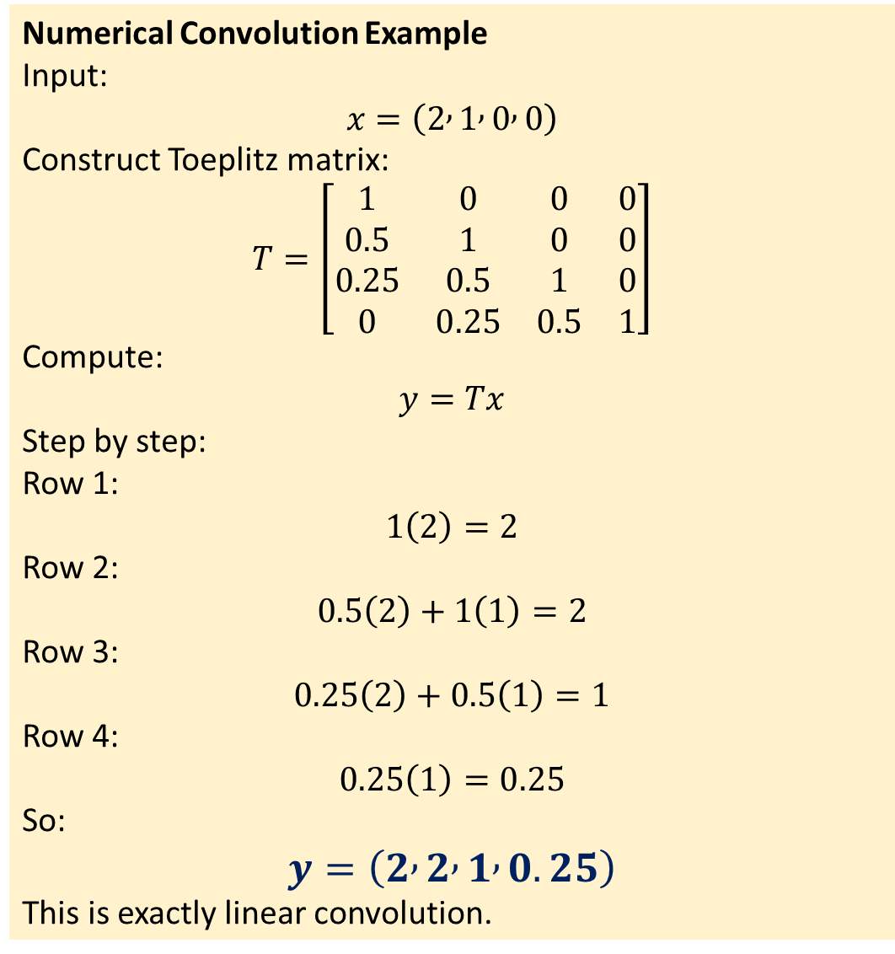
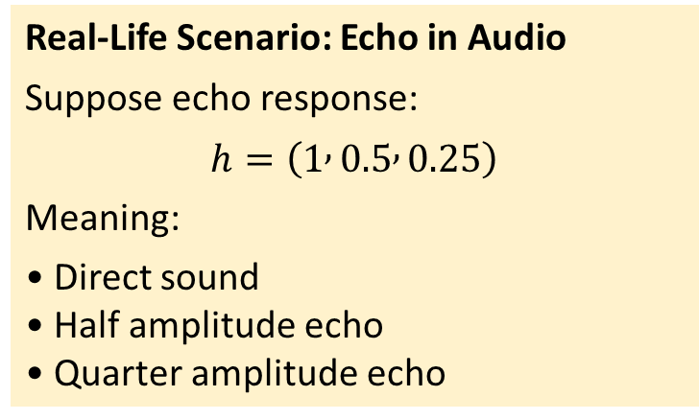
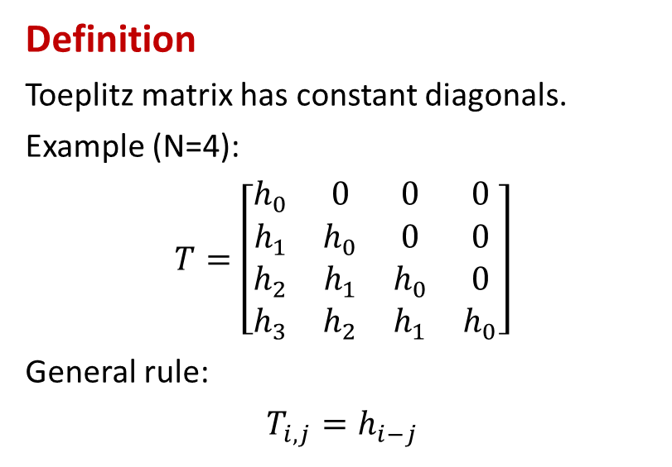
Numerical Convolution Example
Input:
$$x=\left(2 , 1 , 0 , 0\right)$$
Construct Toeplitz matrix:
$$T=\left[\begin{matrix}1 & 0 & 0 & 0 \\ 0.5 & 1 & 0 & 0 \\ 0.25 & 0.5 & 1 & 0 \\ 0 & 0.25 & 0.5 & 1\end{matrix}\right]$$
Compute:
$$y=Tx$$
Step by step:
Row 1:
$$1\left(2\right)=2$$
Row 2:
$$0.5\left(2\right)+1\left(1\right)=2$$
Row 3:
$$0.25\left(2\right)+0.5\left(1\right)=1$$
Row 4:
$$0.25\left(1\right)=0.25$$
So:
$$y=\left(2 , 2 , 1 , 0.25\right)$$
This is exactly linear convolution.
Definition
Toeplitz matrix has constant diagonals.
Example (N=4):
$$T=\left[\begin{matrix}h_{0} & 0 & 0 & 0 \\ h_{1} & h_{0} & 0 & 0 \\ h_{2} & h_{1} & h_{0} & 0 \\ h_{3} & h_{2} & h_{1} & h_{0}\end{matrix}\right]$$
General rule:
$$T_{i,j}=h_{i−j}$$
Real-Life Scenario: Echo in Audio
Suppose echo response:
$$h=\left(1 , 0.5 , 0.25\right)$$
Meaning:
• Direct sound
• Half amplitude echo
• Quarter amplitude echo

Slide 3
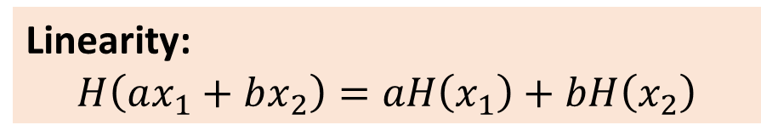
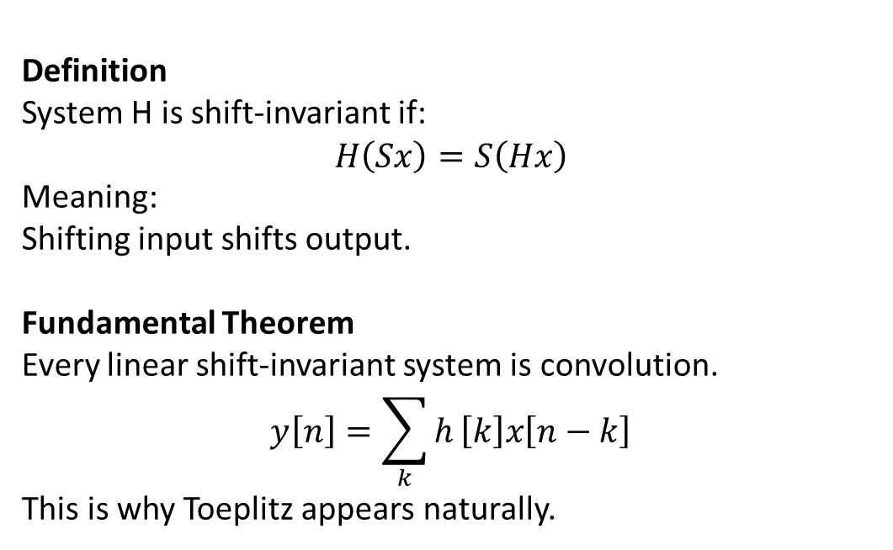
SHIFT-INVARIANT FILTERS
Definition
System H is shift-invariant if:
$$H\left(Sx\right)=S\left(Hx\right)$$
Meaning:
Shifting input shifts output.
Fundamental Theorem
Every linear shift-invariant system is convolution.
$$y\left[n\right]=\sum_{k}{h}\left[k\right]x\left[n−k\right]$$
This is why Toeplitz appears naturally.
Linearity:
$$H\left(ax_{1}+bx_{2}\right)=aH\left(x_{1}\right)+bH\left(x_{2}\right)$$

Slide 4
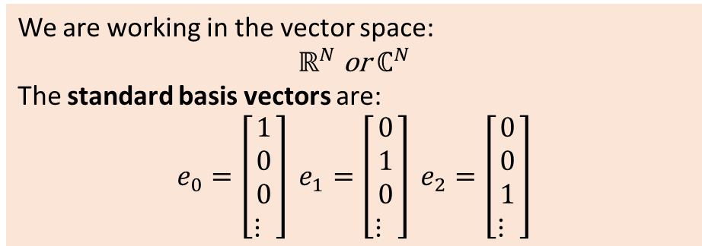
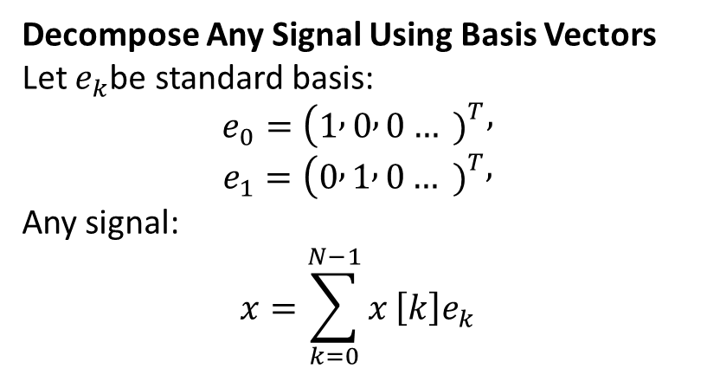
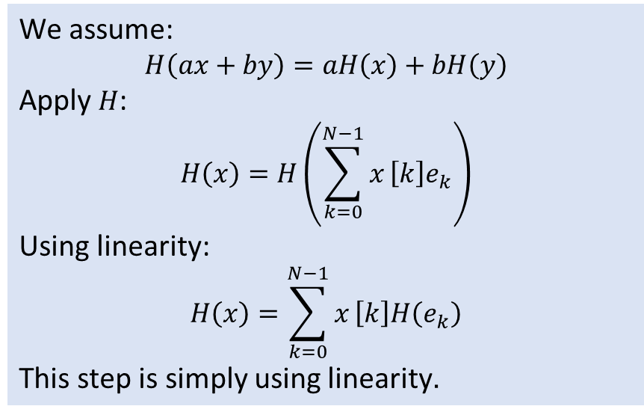
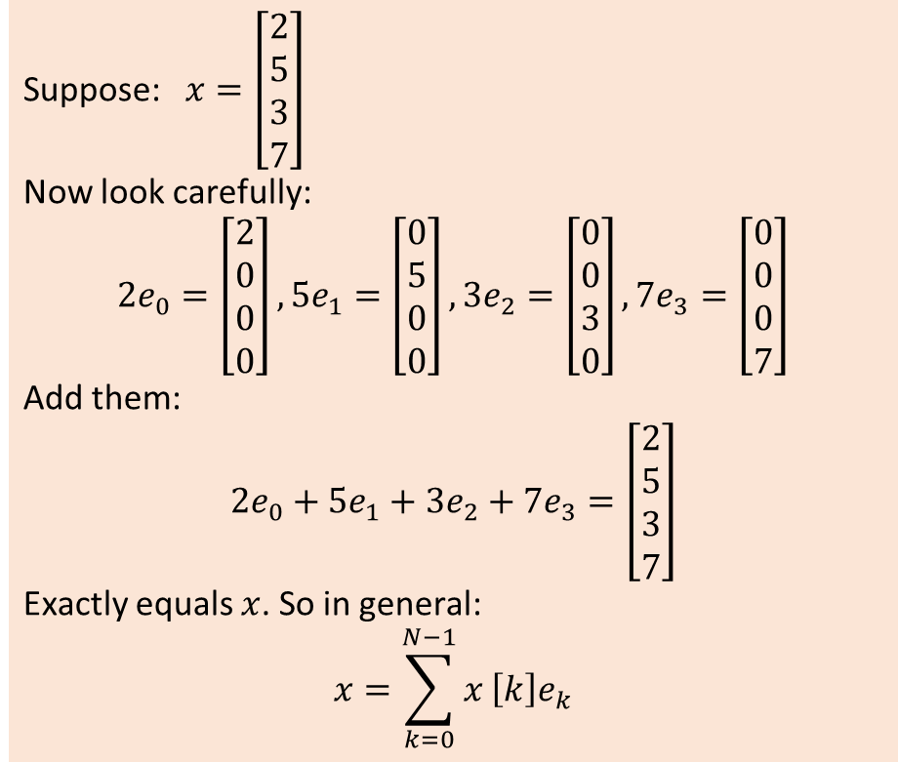
Decompose Any Signal Using Basis Vectors
Let $e_{k}$be standard basis:
$$e_{0}=(1 , 0 , 0… {\left.)\right.}^{T},$$
$$e_{1}=(0 , 1 , 0… {\left.)\right.}^{T},$$
Any signal:
$$x=\sum_{k=0}^{N−1}{x}\left[k\right]e_{k}$$
We are working in the vector space:
$$ℝ^{N} \text{or} ℂ^{N}$$
The standard basis vectors are:
$$e_{0}=\left[\begin{matrix}1 \\ 0 \\ 0 \\ ⋮ \end{matrix}\right] e_{1}=\left[\begin{matrix}0 \\ 1 \\ 0 \\ ⋮ \end{matrix}\right] e_{2}=\left[\begin{matrix}0 \\ 0 \\ 1 \\ ⋮ \end{matrix}\right]$$
Suppose: $x=\left[\begin{matrix}2 \\ 5 \\ 3 \\ 7\end{matrix}\right]$
Now look carefully:
$$2e_{0}=\left[\begin{matrix}2 \\ 0 \\ 0 \\ 0\end{matrix}\right], 5e_{1}=\left[\begin{matrix}0 \\ 5 \\ 0 \\ 0\end{matrix}\right], 3e_{2}=\left[\begin{matrix}0 \\ 0 \\ 3 \\ 0\end{matrix}\right], 7e_{3}=\left[\begin{matrix}0 \\ 0 \\ 0 \\ 7\end{matrix}\right]$$
Add them:
$$2e_{0}+5e_{1}+3e_{2}+7e_{3}=\left[\begin{matrix}2 \\ 5 \\ 3 \\ 7\end{matrix}\right]$$
Exactly equals $x$. So in general:
$$x=\sum_{k=0}^{N−1}{x}\left[k\right]e_{k}$$
We assume:
$$H\left(ax+by\right)=aH\left(x\right)+bH\left(y\right)$$
Apply $H$:
$$H\left(x\right)=H\left(\sum_{k=0}^{N−1}{x}\left[k\right]e_{k}\right)$$
Using linearity:
$$H\left(x\right)=\sum_{k=0}^{N−1}{x}\left[k\right]H\left(e_{k}\right)$$
This step is simply using linearity.

